Slide 1
Administration

Slide 2
Tenant Management
Tenant Management is done by Tenant Administrator or “super user”
Super User account is created during installation
By default, a “default” tenant is created.
To login to tenant manager, use this URL
http://[host]:[port]/console/TenantManager.page
Tenant Manager can
Add/Delete Super Users
Manage BPM configuration Properties
Add/Delete Tenants
Manage Tenant Properties
Notes:
Users with Admin Role can view logs and configure their location and rotation.

Slide 3
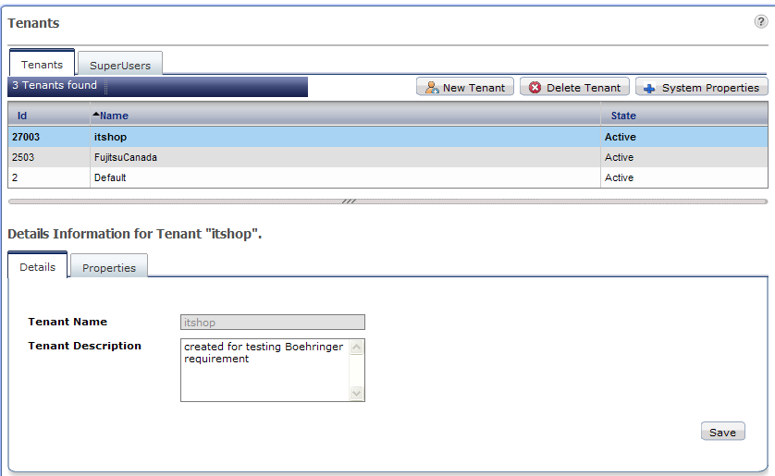
Tenant Manager Console

Slide 4
Create Tenant
To create a new tenant
Right click and select “Create New”
Step1: Provide “Tenant Name” and description
Step2: Create an admin user
Step3: specify User directory type
User directory is used for authentication and authorization
Local: BPM database is used to store user credentials
Remote: provide connection information to connect to LDAP or AD
Select “Create”
Right click on Tenant name in the list and select “Activate”
Tenant is created with default properties
To update properties, open “properties” tab, change the properties and Save

Slide 5
Managing Console Environment
System Administration tab is visible only to Tenant Admins
Tenant Administrator can
Manage Users and Groups (for local directory setting only)
Login Sessions: view all active sessions and ids
Manage Applications
Manage Configurations
Server/Console Configuration
Logging configurations
Skins
Logos
Admin and Process Owner can
Manage Processes
Publish
Archive processes
Change owners

Slide 6
Application Management
Basic Operations
Start/Stop applications
Modify, Uninstall/Delete applications
Modify Owner
Export
Access Key
Encryption key that will allow the users to access the application from external systems like Email and JMS
Application Variable
Admin can view and update application variables

Slide 7
Application Management
Create App Space
For creating dynamic processes in a separate application, app space needs to be created first.
Admin can create app space and assign owner to the app

Slide 8
Application Management
Synchronize with DMS
This function allows synchronizing application files with DMS. Ideally these two will be in sync but may get out of sync for variety of reasons
For example: two separate BPM consoles are connected to one server, when applications are deployed on one console, other gets out of sync.
On synchronizing, if
DMS is more up to date, console is updated with DMS
DMS is outdated, warning message is displayed with information
Application folder/space is missing, error message is displayed
Synchronize with Repository
If WebDAV repository is used for storing files and documents, this option will synchronize console with repository.

Slide 9
Application Management: Settings
Settings tab in application details provide options to customize application area of console.
Dashboard Settings
Create application specific dashboards
Select available panels
Change dashboard background color
Users can further customize panel settings for their profiles.

Slide 10
Application Management: Settings
Decision Table Settings
View available decision tables
Customize Application Accordions
Customize console left-hand menu and main menu items
Menu cannot be customized for individual users, there are only two views supported, “Admin Users” and “Non Admin Users”
* [Dashboard|getDashboard.page]
* [Tasks|getMyTasks.page]
** [My Tasks|getTaskListDisplay.page|icon->web/images/icon_MyTasks.gif]
** [My Team Tasks|getTeamTasks.page|icon->web/images/icon_MyTeamTasks.gif]
** [Task Searches|searchTask.page|icon->web/images/icon_Searches.gif]
* [Analytics|analytics.page#url:'connectAnalytics.page']
* [Community|cmntManager.page]
**[My Pages|wikilistShow.page?actionName=myWikiList]

Slide 11
Application Management: Settings
Skins
Each application may have its own logo and style-sheet for personalization
To change, copy images and style-sheets in following folder
Logo: “<console Installation Directory>/tenants/<tenantName>/apps/<Application ID>/web/images”
Style sheet: “<console Installation Directory>/tenants/<tenantName>/apps/<Application ID>/web/styles”
Select image and style sheet from drop down and apply

Slide 12
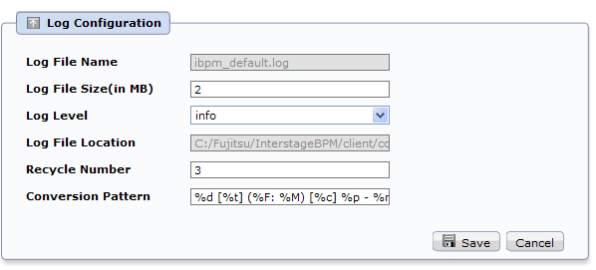
Log Configuration
Change log configuration to control
The information to be logged
Log file size
Number of backup files to be kept etc.

Slide 13
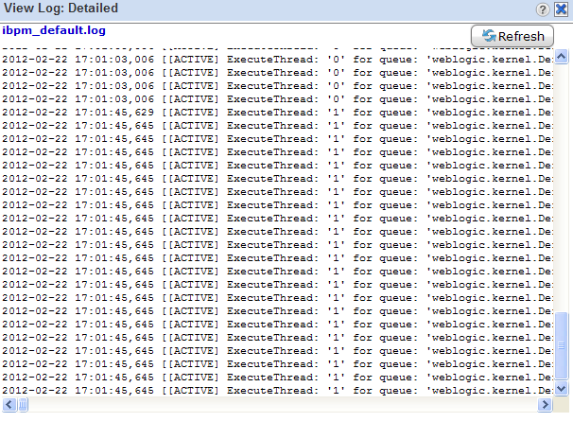
View Log
Admin can access server log in the console

Slide 14
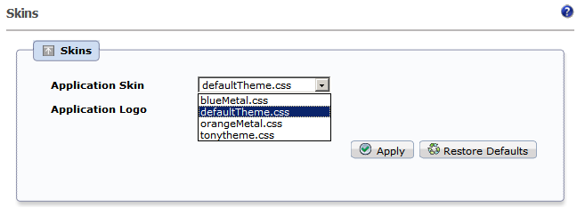
Console Skin
Admin can also update console skin (logo and style-sheet)
Three style sheets are provided by default
Notes:
Change the Skin to one of the already configured ones or add your own.
To Add your own copy the CSS to \Interstage\J2EE\var\deployment\ijserver\IBPMConsoleWU\apps\console.war\web\styles
Example: New theme tonytheme.css created by copying one of the other css files.
Restore back to original by selecting “Restore Defaults” button

Slide 15
Process Administration
Process Archiving
Old process instances can be archived (archiving improves performance)
Only process instances in Closed, Aborted, or Error state can be archived.
Archiving a process instance is one step short of permanently deleting it. While you can view the details and history of an archived process instance, you can neither edit it, nor access its BPMN view
Archival is irreversible. Once archived, a process instance cannot be reinstated; it can only be deleted.
To archive a process instance
Open the “Summary” tab and click “archive”
Archived processes can be accessed by selecting “All/My Archived Process” filter in “My Process”

Slide 16
Process Administration
Process Migration
When a process definition is updated and deployed, all new instances will use updated definition, but already running instances continue to use the old process definition
If old processes are also required to be updated, they can be migrated to new version of definition.
To migrate a process
Right click on process in the list and select “migrate”
User will be asked to specify options to migrate.
Multiple process instances can be selected and migrated in batch
Result summary will provide details of successfully migrated and failed process

Slide 17
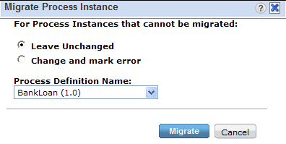
Process Administration
Migration Setting
Leave Unchanged
If migration fails for a process, skip that process
Change and mark error
Migrate to new definition and change the state to “Error”
Dropdown provides list of all available definitions, select the target definition and select “Migrate”

Slide 18
Process Administration
Migration Restrictions
Migration preserves the process instance state as long as all the active tasks (activities) have matching names in the destination process definition
If an activity in the source process instance has no correspondingly named activity in the destination process definition, the source process activity will be considered to be "removed“
If an activity in the destination process definition has no correspondingly named activity in the source process instance, the destination process activity will be added to the source process instance
Target definition must have an activity matching the name of currently active activity in source process.
If the assignee of an active node is changed during migration, the corresponding work item is not changed

Slide 19
DMS Configuration
Interstage BPM can be configured with a DMS repository that supports WebDAV
Default repository is file based. There can be more than one DMS configured with a tenant
To change DMS repository
Update DMS configuration
DMS Configurations are stored in DmsCollections.xml
“BPM Installation Directory>/ server/instance/default/tenants/<tenantName>/resources/DmsCollections.xml”
<Dms>
<Path>C:/Fujitsu/InterstageBPM/attachments</Path>
<ImplementationClass>com.fujitsu.iflow.dmsadapter.impl.FileSystemDmsSessionImpl</ImplementationClass>
<Name>Attachments</Name>
</Dms>

