Slide 1
Interstage BOP SQL Query Tutorial
Todd Palmer
October 2012

Slide 2
Introduction
This tutorial explains how to create Web Services that invoke customized SQL queries from database tables.
All SQL Queries are invoked from a Web Service
This tutorial includes:
Dynamic Query: SQL Queries other than the basic ones
Dynamic Filters: SQL Queries with inputs
Populating a Select where no enumeration table exists

Slide 3
Prerequisites
You should already have completed Chapter 1 of the Developing Services training.
You should have at least a cursory understanding of Database tables, SQL queries, and primary and foreign keys.
You understand how to create User Interfaces that use Web Services as described in the chapter on User Interfaces in the BOP Fundamentals Training.
This tutorial leverages the Northwind database installed in the downloadable Community VM.

Slide 4
Dynamic Queries
As shown in chapter 1 of the Developing Services training, Interstage BOP will generate basic Web Services.
These include:
Get Object by ID
Get Object List
Get Object List by Foreign Key
Additionally, you can create Web Services that call your own customized SQL queries. These are known as Dynamic Queries.

Slide 5
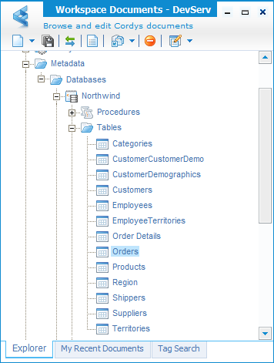
Dynamic Queries
In our first example we will create a Web Service that returns all orders that were shipped to the USA.
Open the Workspace and navigate to:
Metadata/Databases/Northwind/Tables
Open the Orders table.

Slide 6
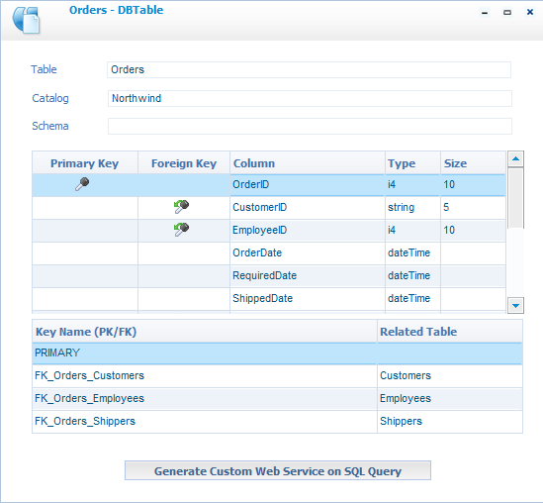
Dynamic Queries
The table dialog shows the metadata of the Orders table including:
Columns
Key: Primary and Foreign
Note that ShipCountry is not a Foreign Key so BOP doesn’t automatically generate a Web Service for us to filter by it.
Click: Generate Web Service on SQL Query

Slide 7
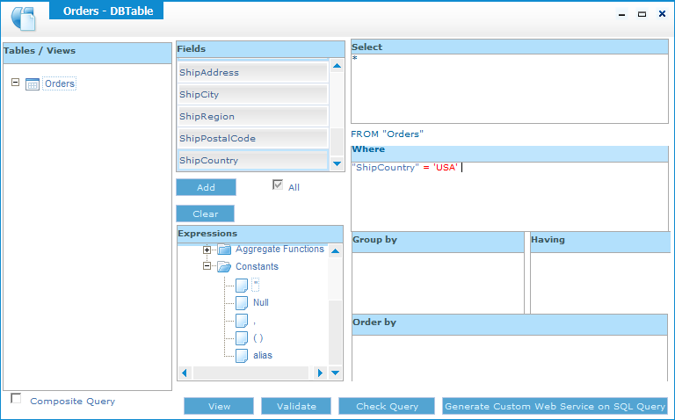
Dynamic Queries
Click in the Select area and click the All checkbox.
In the Where area select ShipCountry and click Add.
Set the operator to = and the value to 'USA'

Slide 8
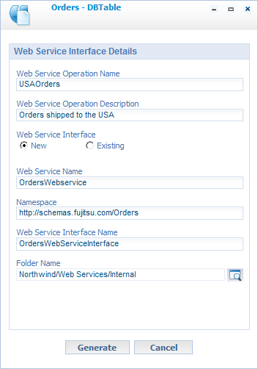
Generate the Dynamic Query
You can click Validate to verify the SQL is valid.
Click Generate Custom Web Service on SQL Query
Web Service Operation Name: USAOrders
Web Service Interface: New
Folder Name: Northwind/Web Services/Internal
Click Generate.

Slide 9
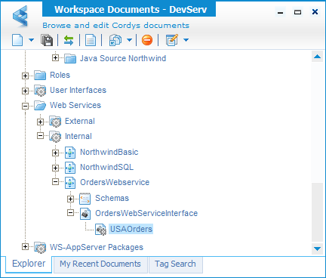
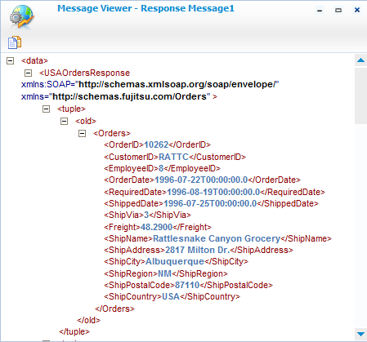
Test the Dynamic Query
Browse and Publish your newly created Web Service.
Right click on the USAOrders Web Service and click: Test Web Service Operation
In the Operation Test Tool click Invoke
Check the response to see that Orders were returned.
Your Web Service is now calling your SQL Query that you dynamically built.

Slide 10
Dynamic Filters
We would really like to be able to pass the Shipping Country into the Web Service.
We want to dynamically filter the results of a table based on some user input.
In BOP this is referred to as a Dynamic Filter.
In BOP we will define the SQL for this query to look like this: SELECT * FROM "Orders" WHERE "ShipCountry"=:ShipToCountry
Notice the colon (:) before the ShipToCountry. This specifies that this part of the query will be supplied at run time.

Slide 11
Dynamic Filters
In this example we will create a Web Service that returns all orders that were shipped to the user supplied country.
Open the Workspace and navigate to:
Metadata/Databases/Northwind/Tables
You could open the table. However, this time just right click on the Orders table and select: Generate Custom Web Service on SQL Query

Slide 12
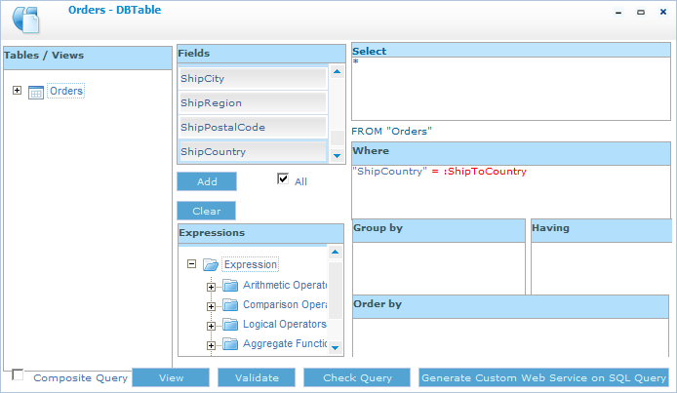
Dynamic Filters
Click in the Select area and click the All checkbox.
In the Where area select ShipCountry and click Add.
Set the operator to = and the value to :ShipToCountry

Slide 13
Dynamic Filters Implementation
Let’s take a look behind the scenes and see how BOP actually implements this query.
You probably won’t be surprised that BOP uses XML to internally represent this query.
You can see this XML by clicking on View.
Notice the parameter element:
It has a ShipToCountry child for our Dynamic Filter
dd specifies the ShipCountry column in the Orders table
dt specifies that the type is: string

Slide 14
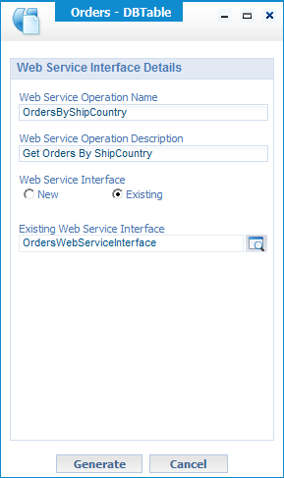
Generate the Dynamic Filter
You can click Validate to verify the SQL is valid.
Click Generate Custom Web Service on SQL Query
We want this Dynamic Filter Web Service added to our existing Interface:
Web Service Operation Name: OrdersByShipCountry
Web Service Interface: Existing
Existing Web Service Interface: OrdersWebServiceInterface
Click Generate.

Slide 15
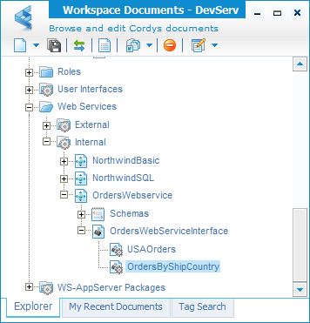
Test the Dynamic Query
Browse and Publish your newly created Web Service.
Right click on the OrdersByShipCountry Web Service and click: Test Web Service Operation

Slide 16
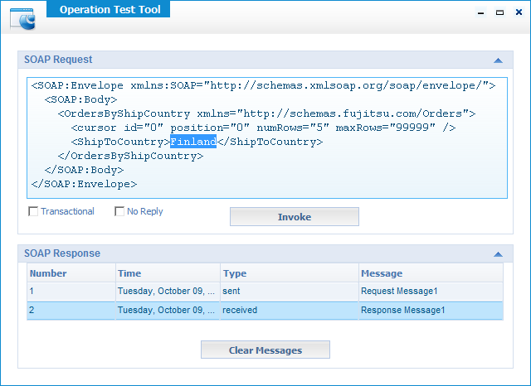
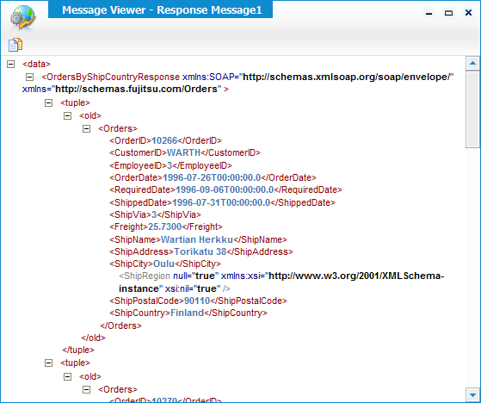
Test the Dynamic Query
Replace PARAMETER in ShipToCountry with Finland.
In the Operation Test Tool click Invoke
Check the response to see that Orders were returned.
Your Web Service is now calling your SQL Query that you dynamically built.

Slide 17
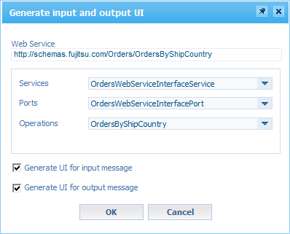
Dynamic Filters in User Interfaces
You can now use your Dynamic Filter Web Service in a User Interface.
Create a new User Interface:
Name: OrdersByCountry
Description: Shows Orders By Ship Country
Drag your OrdersByShipCountry Web Service onto your new User Interface.
Make sure both input message and output message are checked.
Click OK.

Slide 18
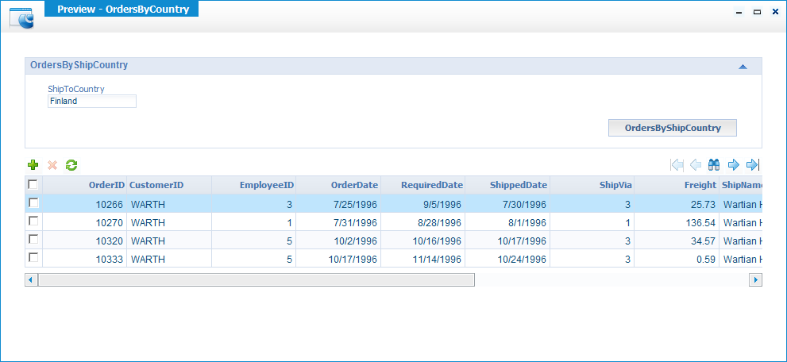
Dynamic Filters in User Interfaces
Preview your User Interface.
In the ShipToCountry field type: Finland
Click on OrdersByShipCountry

Slide 19
Populating a Select Box
In section 3.5.1 of the User Interfaces chapter in the Fundamentals training we saw how to populate a Select box from a database table.
However, that example assumes that the Select box items are enumerated in an existing table.
We will need to make some adjustments to that approach as we don’t have a table of the countries referenced by ID from the Order.

Slide 20
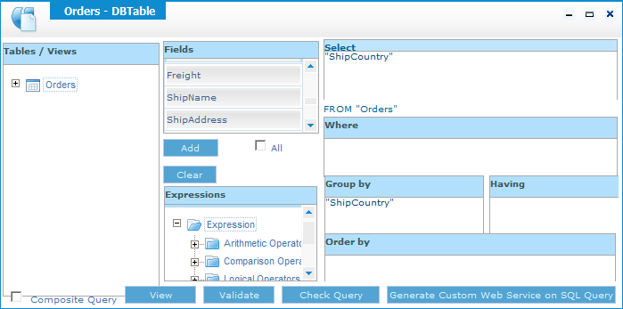
Get Countries Query
The following query returns an enumerated list of all the countries to which we are shipping orders:
SELECT ShipCountry FROM Orders GROUP BY ShipCountry
In the Orders table generate a custom Web Service based on the query.

Slide 21
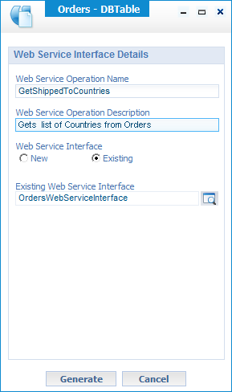
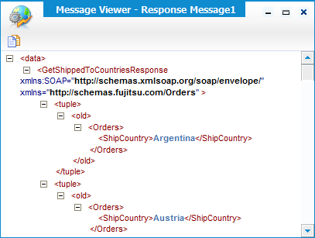
Generate the Web Service
Add this new Web Service to our existing Interface:
Web Service Operation Name: GetShippedToCountries
Web Service Interface: Existing
Existing Web Service Interface: OrdersWebServiceInterface
Click Generate.
Publish and test your Web Service.

Slide 22
Populating the Select
Now that we have a Web Service that returns the list of countries we can use it to populate the Select box.
However, let’s be clear about something before we proceed.
Technically, the query is not returning countries. It is actually returning Orders. That is because it is a query on the Orders table. We have just filtered out all of the other information.
For our purposes this is a good thing as it will allow us to use our existing Orders object.

Slide 23
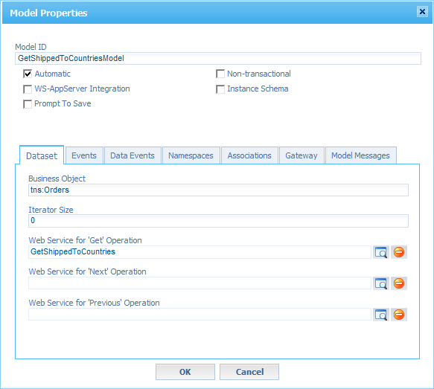
Configure the Select Dataset
Open the OrdersByCountry User Interface.
Right click on the ShipToCountry field and change it to a Select.
In the Properties for the Select click on Edit Dataset Options.
Click Create New Model.
Click Yes to confirm creation of the model.
In the Model Properties set:
Get Operation: GetShippedToCountries
Iterator Size: 0
Uncheck: Prompt To Save
Notice that it correctly sets the Business Object to be Orders.

Slide 24
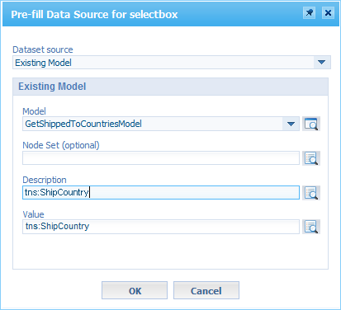
Configure the Select Dataset
Click OK.
In the Existing Model:
For both Description and Value click on Get References from Model and select tns:ShipCountry.
Click OK.

Slide 25
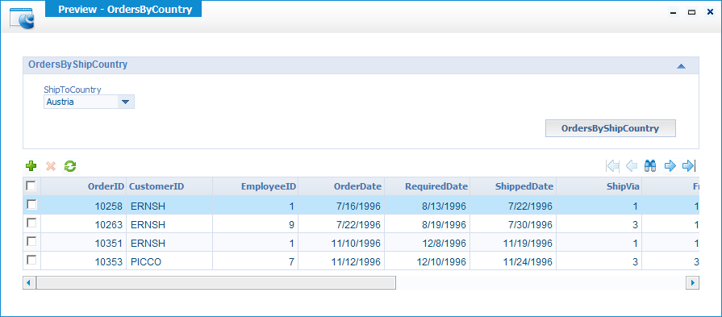
Testing the Select
Preview the User Interface.
Notice that the Select box lists the countries.
Select a country and click OrdersByShipCountry.

Slide 26
Planned Additional Content
Dynamic Sort?
Composite queries?

