Slide 1
Advance features

Slide 2
Chained Subprocess
Chained Subprocess provides same functionality as Subprocess node with few exceptions
Subprocess | Chained Subprocess
Synchronous | Asynchronous
Parent process waits for Subprocess to complete | Parent process continues execution after invoking Subprocess
Data can be exchanged from parent to sub (input) as well as from sub to parent (output on completion) | Data can be exchanged only from parent to Subprocess as input.
Notes:
The Chained-Process Node references a Process Definition which is instantiated and executed asynchronously.
The Process Instance does not need to be instantiated on the same Interstage BPM instance on which the Chained-Process Node was running.
A mapping of data elements is used to provide data to the chained-process.
As soon as the chained-process is started an event is generated on each outgoing arrow.

Slide 3
Remote Subprocess
Remote Subprocess node allows to execute/invoke a process outside the BPM system boundary.
BPM Process can be invoked on another BPM server
Interstage BPM supports two open protocols for communication between workflow servers, these protocols pass XML messages over HTTP between workflow servers
ASAP: Asynchronous Service Access Protocol (recommended)
SWAP: Simple Workflow Access Protocol
To invoke Remote process, provide the ASAP access URL for the remote process in the “Data Mapping” settings.
Notes:
The Chained-Process Node references a Process Definition which is instantiated and executed asynchronously.
The Process Instance does not need to be instantiated on the same Interstage BPM instance on which the Chained-Process Node was running.
A mapping of data elements is used to provide data to the chained-process.
As soon as the chained-process is started an event is generated on each outgoing arrow.

Slide 4
XML UDA
XML UDA allow to store xml data in process as process attribute.
XML data/UDA is useful when working with Web Services
Provides a way to add UDAs dynamically (XML attributes) in process without modifying/editing process.
XML UDAs can be displayed on the form using Table widgets, or XPath can also be used to display attributes separately.
XML UDA can be
Well formed XML: create an XML UDA and ensure to store valid XML structure
Valid XML: specify schema to validate XML structure against
Studio generates XPath wherever applicable for easy mapping of XML (UDA) attributes with string (UDA) value and vice versa.
Notes:
The Chained-Process Node references a Process Definition which is instantiated and executed asynchronously.
The Process Instance does not need to be instantiated on the same Interstage BPM instance on which the Chained-Process Node was running.
A mapping of data elements is used to provide data to the chained-process.
As soon as the chained-process is started an event is generated on each outgoing arrow.

Slide 5
XML Actions
There are out-of-the-box XML actions to help working with XML UDAs
Available Actions:
Add Substructure in XML
Assign UDA from XPath
Assign XML to UDA
Delete from XML
Set Substructure in XML
Set Text or Attribute Value in XML
Notes:
The Chained-Process Node references a Process Definition which is instantiated and executed asynchronously.
The Process Instance does not need to be instantiated on the same Interstage BPM instance on which the Chained-Process Node was running.
A mapping of data elements is used to provide data to the chained-process.
As soon as the chained-process is started an event is generated on each outgoing arrow.

Slide 6
Add substructure in XML
This action allows to add/insert an XML part in an XML UDA at a specified location.
XML UDA
<?xml version="1.0" encoding="UTF-8"?>
<Body>
<Customers>
<Customer>
<id>1234</id>
<firstName>John</firstName>
<lastName>Doe</lastName>
</Customer>
</Customers>
<Body/>
Updated XML UDA
<?xml version="1.0" encoding="UTF-8"?>
<Body>
<Customers>
<Customer>
<id>1234</id>
<firstName>John</firstName>
<lastName>Doe</lastName>
</Customer>
<Customer>
<id>1234</id>
<firstName>Todd</firstName>
<lastName>Palmer</lastName>
</Customer>
</Customers>
<Body/>
Substructure
<Customer>
<id>1235</id>
<firstName>Todd</firstName>
<lastName>Palmer</lastName>
</Customer>
Notes:
The Chained-Process Node references a Process Definition which is instantiated and executed asynchronously.
The Process Instance does not need to be instantiated on the same Interstage BPM instance on which the Chained-Process Node was running.
A mapping of data elements is used to provide data to the chained-process.
As soon as the chained-process is started an event is generated on each outgoing arrow.

Slide 7
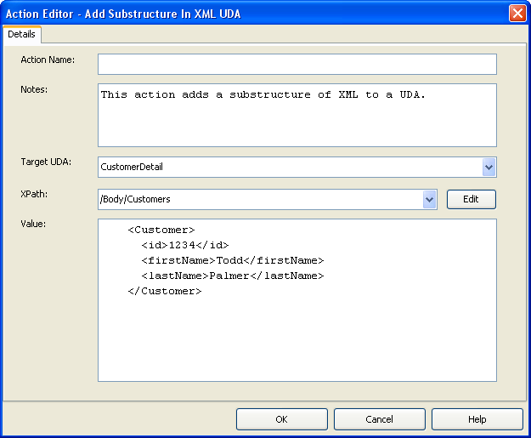
Add substructure in XML
XPath Expression
Substructure to add
Notes:
The Chained-Process Node references a Process Definition which is instantiated and executed asynchronously.
The Process Instance does not need to be instantiated on the same Interstage BPM instance on which the Chained-Process Node was running.
A mapping of data elements is used to provide data to the chained-process.
As soon as the chained-process is started an event is generated on each outgoing arrow.

Slide 8
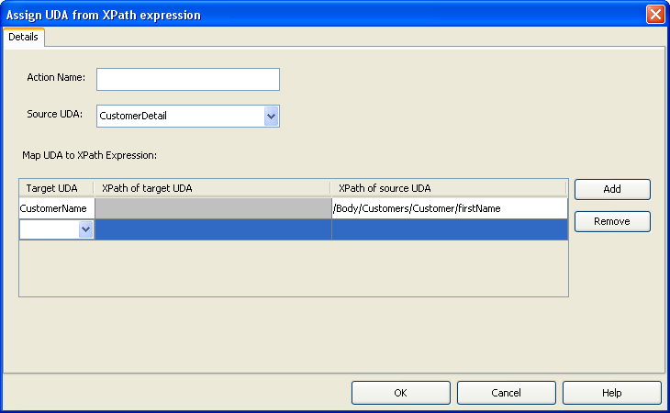
Assign UDA from XPath
Assign UDA value from an XML UDA using XPath
Source UDA is XML
Target UDA
XML – use XPath for source and target
String – use XPath to get value from Source UDA
Notes:
The Chained-Process Node references a Process Definition which is instantiated and executed asynchronously.
The Process Instance does not need to be instantiated on the same Interstage BPM instance on which the Chained-Process Node was running.
A mapping of data elements is used to provide data to the chained-process.
As soon as the chained-process is started an event is generated on each outgoing arrow.

Slide 9
XML Actions
Assign XML to UDA
Assign value to an XML UDA or update value
Delete from XML
Delete value of an element, specified by XPath Expression
Set Substructure in XML
Set a substructure in an XML UDA
As opposed to “Add Substructure..” action, this action replaces existing substructure with new one.
Set Text or Attribute Value in XML
Set value of an element of attribute using XPath expression.
Notes:
The Chained-Process Node references a Process Definition which is instantiated and executed asynchronously.
The Process Instance does not need to be instantiated on the same Interstage BPM instance on which the Chained-Process Node was running.
A mapping of data elements is used to provide data to the chained-process.
As soon as the chained-process is started an event is generated on each outgoing arrow.

Slide 10
Exception Handling Actions
OnSuspend Action
When a process or task is suspended, these actions will execute before suspending
Useful to perform task before suspension, e.g. send email, update database etc.
OnResume Action
When a suspended process or task is resumed, these actions will execute on resuming
Useful to perform task before resuming, e.g. send email, load data etc.
OnAbort Action
When a process or task is aborted, these actions will execute immediately before abort.
Useful to perform task before aborting, e.g. send email, delete data etc.
OnError Action (only for Process and Remote Subprocess Node)
Execute actions to perform task when remote Subprocess fails to start
Notes:
The Chained-Process Node references a Process Definition which is instantiated and executed asynchronously.
The Process Instance does not need to be instantiated on the same Interstage BPM instance on which the Chained-Process Node was running.
A mapping of data elements is used to provide data to the chained-process.
As soon as the chained-process is started an event is generated on each outgoing arrow.

Slide 11
Error Handling
Actions in an action set execute in a single transaction
If any action fails, all updates are rolled back and process goes to error state
Error handling allows catching of exceptions in actions and preventing the process from going to error state
There are two sets of actions available for error handling
Error Action
Compensation Action
Each action may have zero or more error and compensation actions defined.
Notes:
The Chained-Process Node references a Process Definition which is instantiated and executed asynchronously.
The Process Instance does not need to be instantiated on the same Interstage BPM instance on which the Chained-Process Node was running.
A mapping of data elements is used to provide data to the chained-process.
As soon as the chained-process is started an event is generated on each outgoing arrow.

Slide 12
Error Handling
Error Action
Executes when an action fails and throws exception
Catch exception
Perform pre-defined corrective action
Continue process w/o error
Compensation Action
Executes when action fails and throws exception
Does not execute if error action handles exception and process continues without error
Useful to rollback updates outside the BPM transaction context.
Executes in reverse order for all actions in the Action Set
On Task Recall
Compensation actions for target node’s “Prologue Action Set” and for source node’s “Epilogue Action Set” are executed.

Slide 13
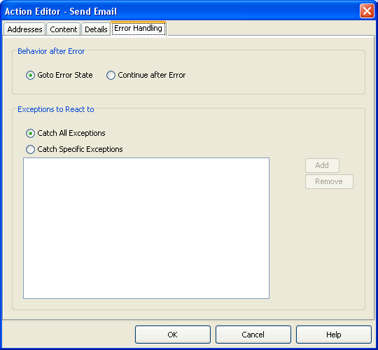
Error Action
Actions added as Error Action have additional “Error Handling” tab
Catch “All” or specific exceptions
Continue to error state or continue without error.

Slide 14
Application Variable
Allows to share data across processes in an application
Great for defining common configuration information.
usage example
WSDL URL can be defined as an application variable and shared across processes
If URL changes, change impact is less and change is easy.
To define application variables:
Right click application → select Properties → select “Application Variable”
All app variables are stored in XML format in Appvariable.xml

Slide 15
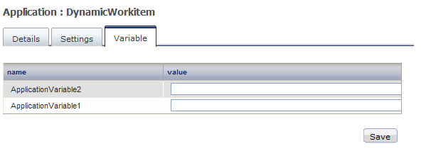
Application Variable
Can be created only in Studio
Can be updated in BPM Console

Slide 16
Process Scheduler
Process Scheduler is a periodic workflow application-level timer that starts process instances, of specified process definitions contained in a workflow application, based on the schedule set in the timer
Can be used with business calendar to control scheduling
Can be set with an expiration time, after which scheduling stops
Process Definition must be in Published state
To setup scheduling
Right click on “resources” folder and select “New→Process Scheduler”
Scheduler configuration is defined in ProcessScheduler.xml file

Slide 17
Process Scheduler
<ProcessScheduler>
<Timers>
<Timer>
<Name>Timer Name</Name>
<ProcessDefinitions>
<ProcessDefinition>Process Definition Name1</ProcessDefinition>
<ProcessDefinition>Process Definition Name2</ProcessDefinition>
</ProcessDefinitions>
<Calendar>Business Calendar File Name</Calendar>
<Schedule>Business Calendar Value</Schedule>
<ExpirationDate>Expiration Date of Timer</ExpirationDate>
</Timer>
</Timers>
</ProcessScheduler>
Tag | Sample Value
Calendar | System uses default if not defined.
Schedule | e.g. WN(1);BT(01:00:00) Next week day (after today) and 1 hour after current time
ExpirationDate | e.g. 2012/12/31

Slide 18
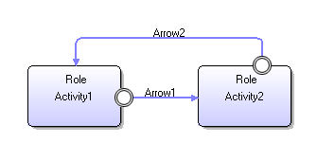
Looping Setting
Activity and Subprocess node can be configured to behave as multi instance nodes that simulates the while loop behavior.
Processing individual line items in an order
sending a response to a list of targets.
Alternate (old) way to provide looping was to create a looping arrow.
Looping setting provides easier way to manage while loops, with much more control over execution settings
Notes:
Before version 11 of Interstage BPM, each Activity, Subprocess and Chained-Process node that was created at design time resulted in a single Activity, Subprocess or Chained-Process being instantiated at run time.
The addition of the “iterator” node functionality in version 11 enables multiple instances of:
activities;
sub-processes; and
chained-processes to be started.
This feature is typically used when:
multiple actions are required to process a request; and
the number of these actions not known at design time.
This could occur, for example, when:
processing individual lines of an order; or
sending a response to a list of targets.

Slide 19
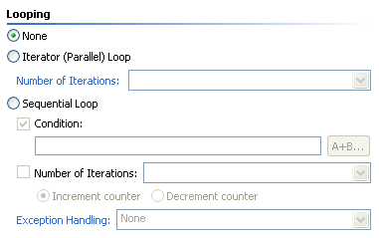
Looping Settings
By Default nodes do not have any looping setting (None)
Looping can be Sequential (looping) or Parallel (iterator)
Number of loops can be defined as “Number of Iterations” using a numerical counter
Increment or Decrement counter setting
Supported only for Sequential looping
Exception Handling
Stop execution in case of error or ignore and continue.

Slide 20
Parallel Looping Behavior
Supported for Activity, Subprocess and Chained Subprocess nodes.
Iterator count is defined by a UDA
Activity Node
“n” number of activity node instances are created depending on UDA value
Process waits for all node instances to complete.
Subprocess Node
“n” number of Subprocess node instances and “n” number of child sub processes are instantiated
Process waits for all Subprocess instances to complete.
Chained Subprocess Node
1 instance of chained Subprocess node instance and “n” number of child subprocesses are instantiated
Process waits for all Subprocess instances to start.
Notes:
The BPMN specification suggests that when multi-instance nodes are processed they can:
occur in sequence (that is one after the other); or
occur in parallel with merging functionality of:
none;
one;
all; or
complex.
In version 11 of Interstage BPM these <c> multi-instance behaviors are supported.

Slide 21
Parallel Looping Behavior
Count: 1
Count: 1
Count: 2
Count: 2
S
E
S
E
Count: 3
Count: 3
Count: 4
Count: 4
Count: ..n
Count: ..n

Slide 22
Parallel Looping Behavior
In parallel looping, all instances are created and execute together.
Action Execution
Prologue and Epilogue Actions are executed only once irrespective of the number of iterations
Role Actions are executed for each iterated node instance
Due Date applies to the entire loop not individual nodes in the loop.
Any update to a UDA is instantly available to all instances.
Iterator instances can be accessed using index variable $index
Notes:
The BPMN specification suggests that when multi-instance nodes are processed they can:
occur in sequence (that is one after the other); or
occur in parallel with merging functionality of:
none;
one;
all; or
complex.
In version 11 of Interstage BPM these <c> multi-instance behaviors are supported.

Slide 23
Parallel Looping Behavior
Task Recall: When Iterator node is source for Task Recall, recall is possible if at least one of the instances is completed.
If all iterator instances are completed
The next activated activity (Target) is de-activated
Compensation actions for prologue of target and epilogue of source (iterator) are executed
Recalled iterator activity instance (source) is re-activated and a task is created and assigned to (recalling) user.
If all instances are not completed
One of the closed iterator instance is re-activated and assigned to current user.
Notes:
The BPMN specification suggests that when multi-instance nodes are processed they can:
occur in sequence (that is one after the other); or
occur in parallel with merging functionality of:
none;
one;
all; or
complex.
In version 11 of Interstage BPM these <c> multi-instance behaviors are supported.

Slide 24
Parallel Looping Restriction
The number of outgoing arrows from an activity iterator node is restricted to one
You cannot use triggers on an iteration-enabled Activity node
Each iterated instance has the same properties (name, description, and so on).
Future work items are not supported for iterated nodes.

Slide 25
Sequential Looping Behavior
Supported for Activity and Subprocess Nodes
Activity Node Looping
Loop-node
Sub-process Node Looping
If true, loop1 start
Evaluate
condition
Looped- Instance
Evaluate
condition
S
E
If true, loop1 start
S
+
E
+
true
Loop:1
true
+
Loop:1
Evaluate
condition
Evaluate
condition
Make Choice on loop: 1,
Then evaluate condition
Evaluate
condition
S
Complete sub process on loop:1, Then evaluate condition
S
E
true
true
true
If true, node
instance(loop2) and the out-going arrow
is created.
Then activated.
S
E
S
E
Loop:1
Loop:2
If true, node instance(loop2) and the out-going arrow is created. Then it is activated and sub process is created.
+
+
Loop:1
Loop:2
S
S
S
E
S
E
Evaluate
condition
Evaluate
condition
false
S
E
false
If false, go to next node
Loop:1
Loop:2
Loop:n
If false, go to next node
S
+
+
+
E
Loop:1
Loop:2
Loop:n
S
S
E
S
S
E
S
S
E
If the first evaluating condition is false, do nothing at the activity (will be “Closed” state) and go to the next node.
While a specified condition is true, new Sub-process is created. If the first evaluating condition is false, no sub process is created and the sub-process node instance will be “Closed” state.

Slide 26
Sequential Looping Behavior
Number of iterations or “max loop count” can be specified using a UDA or a constant value.
Increment or decrement counter specified is evaluated after every loop instance completes to check if more needs to be created.
Conditions can be used to control the instance creation
Complex condition can be created using UDAs and constants
If condition evaluates to false, instance is not created and next loop count is evaluated.
Example: if uda.EmpType == “temp”

Slide 27
Sequential Looping Behavior
Exception handling allows to control the behavior if one of the loop instance fails.
None
no exception handling will be done and process will go to error state
Ignore and continue the loop
error instance will be ignored and next instance in the loop will be activated
Break the loop
loop is broken and process moves to next step.
These options will work only for loop-node if an error occurs in prologue, Role,
Epilogue Actions or Agent execution

Slide 28
Sequential Looping Behavior
If sequential loop node has more than one incoming arrows, closed instances are reused.
Example:
Act1 activity has sequential node setting
Max count = 10
3 instances are created and loop was broken, count UDA is updated to 7
On “Returned” Act1 gets activated again and this time it tries to create 7 instances
3 completed instances are reactivated and 4 new are created (unless loop is broken before that)
Returned
PD:
S
Act1
Act2
E

Slide 29
Sequential Looping Behavior
Transaction Management
Case 1: No error occurred
Case 2: Prologue JA error
with Ignore/break option
Case 3: Epilogue JA error
with Ignore/break option
S
InTxn:true
E
InTxn:true
InTxn:true
S
E
S
E
Txn
Activation
Break Txn
Activation
Break Txn
Activation
InTxn:true
InTxn:true
InTxn:true
InTxn:true
InTxn:true
InTxn:true
InTxn:true
InTxn:true
InTxn:true
Txn
Ignore Txn
Ignore Txn
Make
Choice
Error in prologue JA
Activation
Error in epilogue JA
Activation
Make
Choice
Activation
Make
Choice
Make
Choice

Slide 30
Sequential Looping Restrictions
Future work items not supported
Recalling work items work as normal
Timer or Due Date cannot be used on Sequential Loop Node
Process definitions and instances which have Sequential Loop Nodes, cannot be archived or migrated.

Slide 31
Iterator Node – Example
Variable1:XML
<items>
<item>item1</item>
<item>item2</item>
<item>item3</item>
</items>
Contains a Subprocess Iterator Node.
Iteration Count = 3
Variable1:XML
<items>
<item>item1</item>
<item>item2</item>
<item>item3</item>
</items>
Parent-PD
UDA Mapping
Variable1:/items/item[$index]
Process instance
Parent
3 iterated Subprocess instances are spawned
INOUT
Run
Variable1:/item
Variable1:XML
Variable1:XML
Variable1:XML
Variable1:XML
<item>blah</item>
Child-PD
<item>item1</item>
<item>item2</item>
<item>item3</item>
Subprocess #1
Subprocess #2
Subprocess #3
Notes:
In this example an order is received for three items and the “parent” process calls a “child” Subprocess for each item.
<c> The “parent” process contains an “XML” UDA variable with information for the complete order.
<c> It also contains a UDA variable used as the “Iterator Count” which contains the value 3 (derived from the XML).
<c> The “parent” Process Definition contains a mapping of UDA between the “parent” process and the “child” Subprocess.
In this mapping the $index variable is used to map one item from the order to one Subprocess.
<c> When the “parent” process is executed <c> the Subprocess Node is activated with the XML UDA containing the order.
<c> Three iterated Subprocesses are spawned each with its own subset of the order data.

