Slide 1
Java Actions

Slide 2
Java Actions – Server Actions
Assign Task To User
Assign Task to Performer of Completed Activity
Escalate Task
Evaluate Script
Get Performer
Get Process Initiator
Make Choice
Set Activity Priority
Set Assignee From Relationship
Set Process Instance Name
Set Process Instance Priority
Set Process Instance Description
UDA Assignment

Slide 3
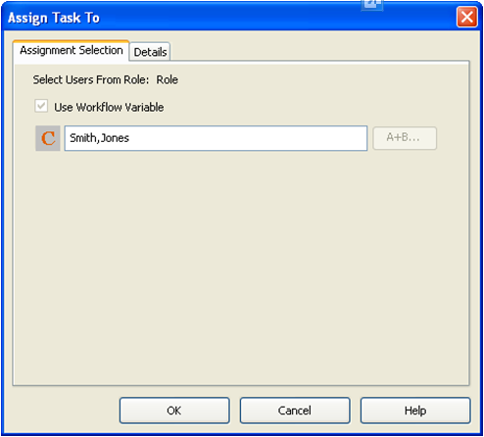
Assign Task To User
Assign task to user or users at runtime (dynamic task assignment)
Assign using
Comma separated list of users
UDA
Java script
Note:
Can assign the activity only to users within the Role to which the activity is currently assigned
User must exist in the system, or node will go to error state.

Slide 4
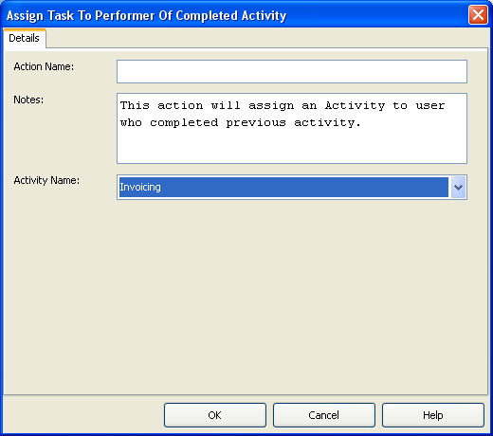
Assign Task to Performer of Completed Activity
Assign task to user who completed previous task.
User from any of the completed activity can be used for assignment.
Assign using
Select the name of completed activity from dropdown.
Note
Can assign the activity only to users within the Role to which the activity is currently assigned

Slide 5
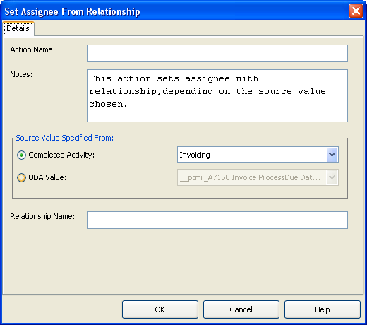
Set Assignee From Relationship
Assign task based on relationship e.g. “manger of the user who completed previous task”
Relationship source
Relation (“manager”) with user of previous activity
Relation with username in the UDA
Source | Relationship | Target
Jim | Manager | Robert
Fujitsu | Executive | Bob
Note
Relationship mappings should be stored as user profiles in the Directory Service or local user store, where the source value is a user ID, relationship is a user attribute name, and target value is a user attribute value

Slide 6
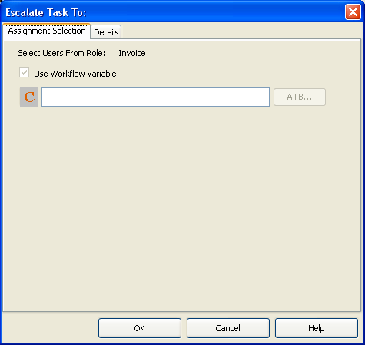
Escalate Task
Escalate task to another user if SLAs are violated.
Same assignment option as “Assign Task to User” action.
Note:
Can be used in an Activity, Voting and Compound node
can be used only as Due Date and Timer’s Timer Action

Slide 7
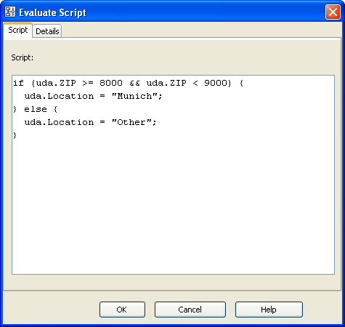
Evaluate Script
Execute a JavaScript function
Can be used to change UDA values or perform other BPM actions.
Example:
Change value of Location UDA based on ZIP UDA value
Notes:
The “Evaluate Script” Java Action enables JavaScript to be used to manipulate User Defined Attributes.
This allows for procedural processing within the context of a Process Instance.
As well as the standard (ECMA-262) functions of JavaScript Interstage BPM provides its own set of JavaScript functions to manipulate the process instance.
User defined JavaScript extensions can also be used.

Slide 8
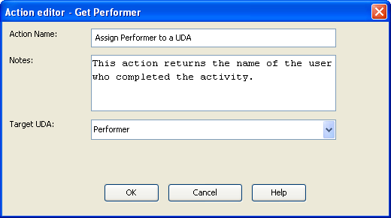
Get Performer
identify the user who completed the task
Assign the user name to a process UDA
Note:
Can be used only as an epilogue action in Activity, Voting and Compound node
Can be used to get the performer of the current node (node it’s assigned to) only
Notes:
The “Evaluate Script” Java Action enables JavaScript to be used to manipulate User Defined Attributes.
This allows for procedural processing within the context of a Process Instance.
As well as the standard (ECMA-262) functions of JavaScript Interstage BPM provides its own set of JavaScript functions to manipulate the process instance.
User defined JavaScript extensions can also be used.

Slide 9
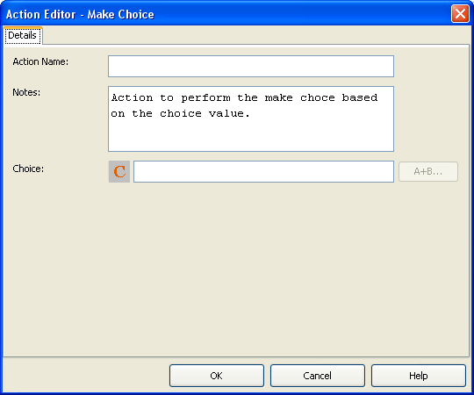
Make Choice
Make choice on nodes automatically in case SLAs are violated.
Choice name can be typed in or assigned from a UDA or script
Note:
Can be used only in Activity, Voting and Compound node
Can be used only as Timer action for Due Dates and Timers
Notes:
The “Evaluate Script” Java Action enables JavaScript to be used to manipulate User Defined Attributes.
This allows for procedural processing within the context of a Process Instance.
As well as the standard (ECMA-262) functions of JavaScript Interstage BPM provides its own set of JavaScript functions to manipulate the process instance.
User defined JavaScript extensions can also be used.

Slide 10
Other Server Actions
Get Process Initiator
Assign the user name, who started current process instance, to a UDA.
Set Activity Priority
Assign/Change priority of activities
Available for Activity, Voting and Compound Nodes
Can be used only as a Prologue Action
Set Process Instance Priority
Assign/Change priority of activities
Constant, UDA or script can be used for assignment
Values should be integer or long
Notes:
The “Evaluate Script” Java Action enables JavaScript to be used to manipulate User Defined Attributes.
This allows for procedural processing within the context of a Process Instance.
As well as the standard (ECMA-262) functions of JavaScript Interstage BPM provides its own set of JavaScript functions to manipulate the process instance.
User defined JavaScript extensions can also be used.

Slide 11
Other Server Actions
Set Process Instance Name
Change/Set the name of Process Instance
UDA, Constant or script can be used to assign the name
Set Process Instance Description
Change/Set the name of Process Instance description
UDA, Constant or script can be used for assigning the value
Notes:
The “Evaluate Script” Java Action enables JavaScript to be used to manipulate User Defined Attributes.
This allows for procedural processing within the context of a Process Instance.
As well as the standard (ECMA-262) functions of JavaScript Interstage BPM provides its own set of JavaScript functions to manipulate the process instance.
User defined JavaScript extensions can also be used.

Slide 12
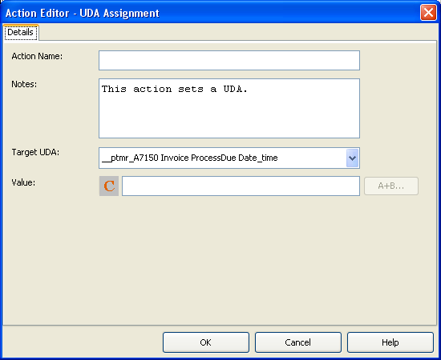
UDA Assignment
Assign/change UDA value
Assignment Option
Select target UDA from drop down
Assign constant value
Assign value from another (source) UDA
Assign value from script
Note
Data type of source UDA or the source data must be compatible with the data type of Target UDA

